Slide 1
Davie's Burgers Subway Ad
Analyze Data with SQL
Name – Ankit Anshu

Slide 2
Davie's Burgers Subway Ad
Analyze Data with SQL
Problem Statement:
Well, Davie's Burgers restaurant business has been booming and it is now looking to place
a catchy advertisement in the local subway station.
Help them dig into their orders table to see if there is anything interesting in there for a funny
tagline!

Slide 3
Task needs to be achieved:
What are the column names?
How recent is this data?
Write a query that selects only the “special_instructions” column.
Edit the query so that we are only returning the special instructions that are not empty?
Sort the instructions in alphabetical order (A-Z).
Let’s search for special instructions that have the word ‘sauce’.
Let’s search for special instructions that have the word ‘door’.
Let’s search for special instructions that have the word ‘box’.
Wow, some of these are marketing gold! But what are their order numbers?
Instead of just returning the special instructions, also return their order ids.

Slide 4
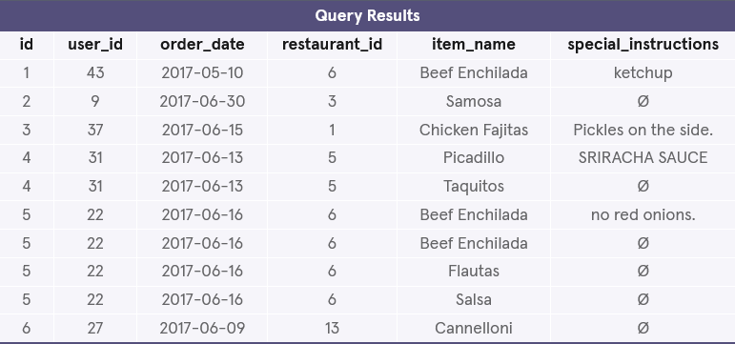
1. What are the column names?
The orders table has the following column names:
id
user_id
order_date
restaurent_id
item_name
special_instruction
select *
from orders
limit 10;

Slide 5
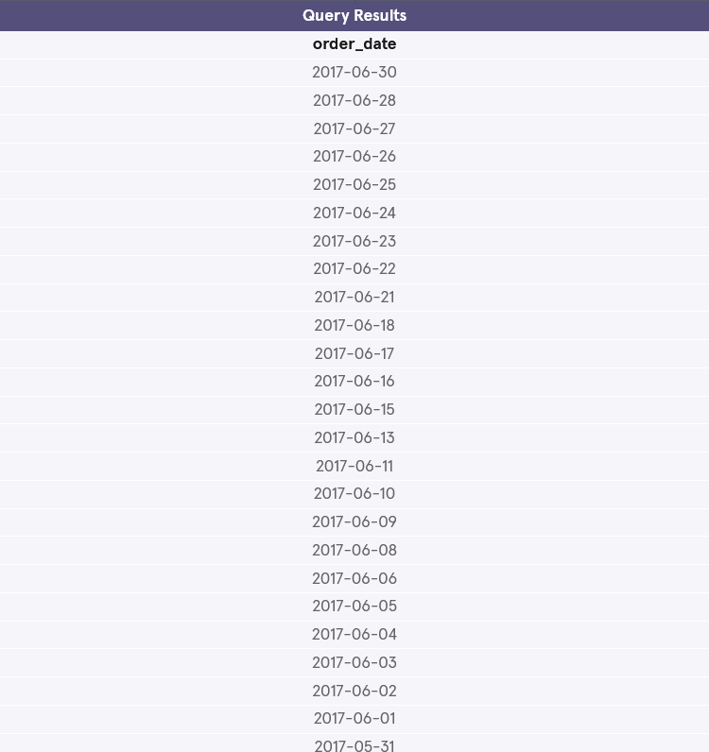
2. How recent is this data?
It looks like this data is from May and June of 2017.
select distinct order_date
from orders
order by order_date desc;

Slide 6
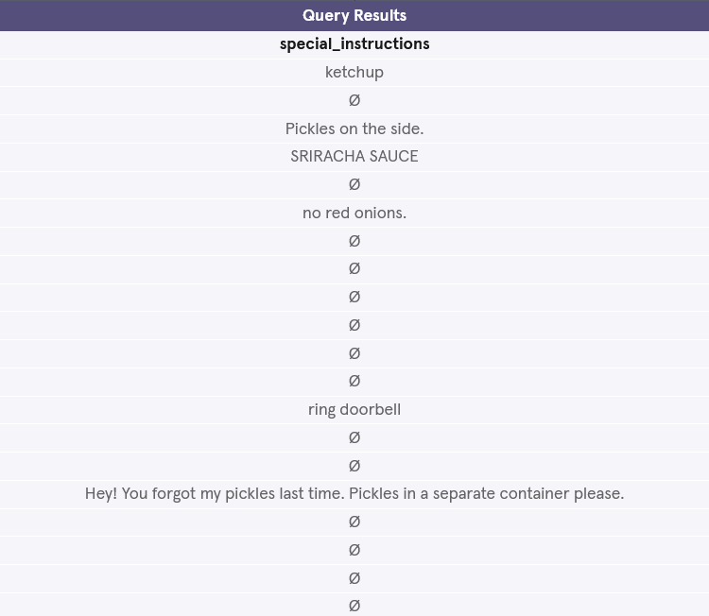
3. Write a query that selects only the “special_instruction” column
The special_instructions column stores the data where Davie’s Burgers customers leave a note for the kitchen or the delivery.
Limit the result to 20 rows.
select special_instructions
from orders
limit 20;

Slide 7
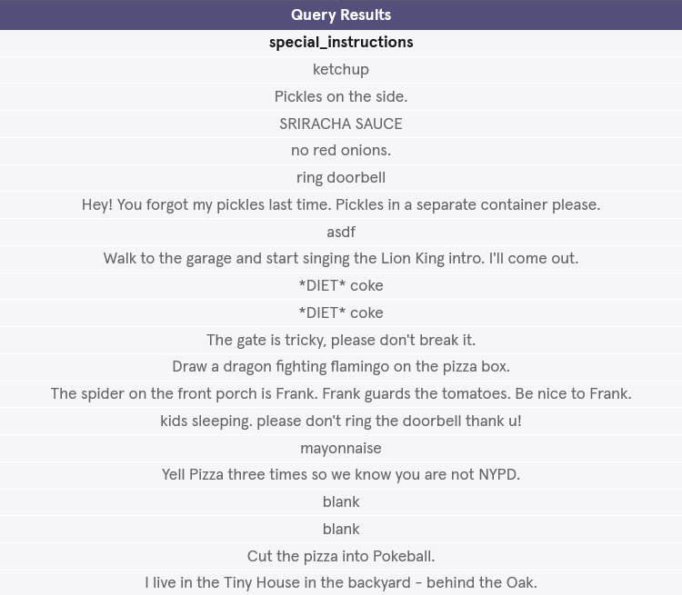
4. Edit the query so that we are only returning the special instructions that are not empty?
There seem to be a lot of empty values in that column. That is because customers sometimes leave the notes section blank.
select special_instructions
from orders
where special_instructions is not null
limit 10;

Slide 8
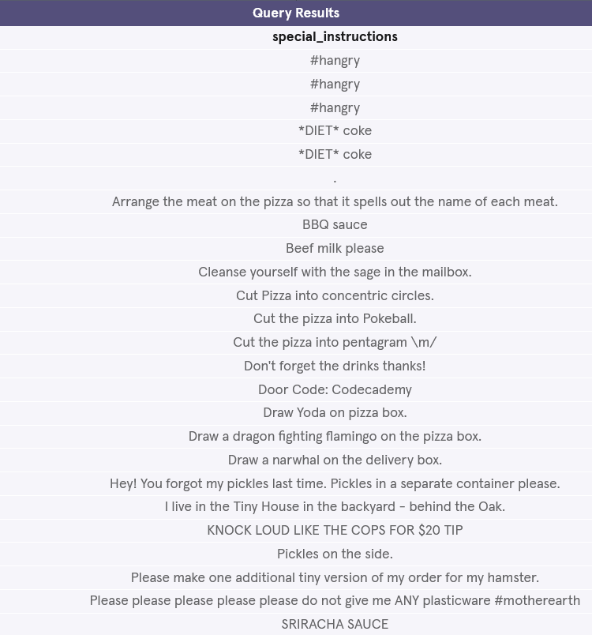
5. Sort the instructions in alphabetical order (A-Z).
select special_instructions
from orders
where special_instructions is not null
order by special_instructions asc;

Slide 9

6. Let’s search for special instructions that have the word ‘sauce’.
select special_instructions
from orders
where special_instructions like '%sauce%';

Slide 10
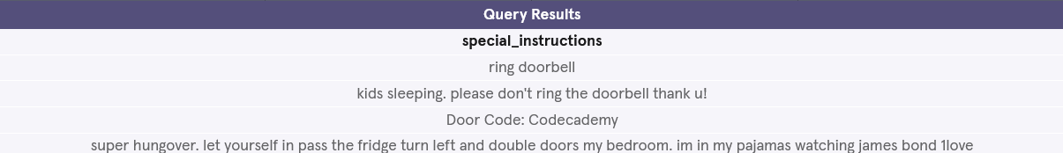
7. Let’s search for special instructions that have the word ‘door’.
select special_instructions
from orders
where special_instructions like '%door%';

Slide 11
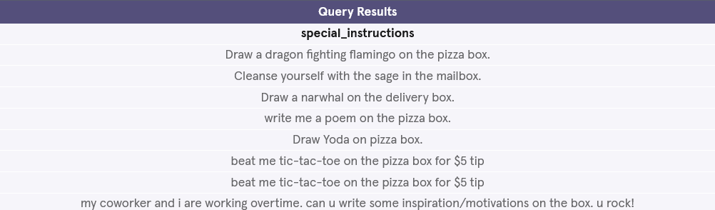
8. Let’s search for special instructions that have the word ‘box’.
select special_instructions
from orders
where special_instructions like '%box%';

Slide 12
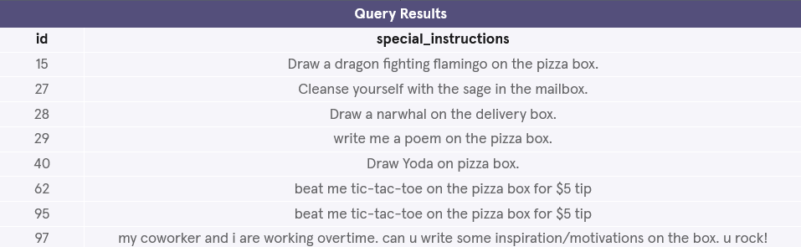
9. Wow, some of these are marketing gold! But what are their order numbers?
select id,
special_instructions
from orders
where special_instructions like '%box%';

Slide 13
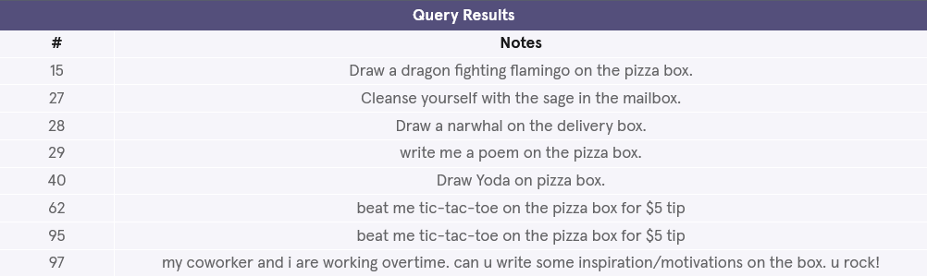
10. Instead of just returning the special instructions, also return their order ids.
For more readability:
Rename id as ‘#’
Rename special_instructions as ‘Notes’
select id ,
special_instructions
from orders
where special_instructions like'%box%';

